Slide 1

MathQ
Answer Generation for Sinhala Arithmetic Problems
Supervised by Mrs. Niwarthana Kariyabadu
Project by Shenal Anthony – W1742306 | 2018383

Slide 2
Agenda
1 - Research Problem
3 - Project Aim
5 - Implementation
7 - Testing & Evaluation
9 - Conclusion
2 - Research Gap
4 - Design of System
6 - Demonstration of the Prototype
8 - Limitation & Enhancements

Slide 3
Research Problem
Mathematics is a mandatory subject for students.
Sinhala mathematics representation is different compared to English mathematics.
Not all student can perform well in solving mathematic problems. (Why Math Is So Hard for Some Students, 2019)
Student intend to skip the whole subject when they don’t get the expected answers for mathematical problem.
Reference
ThoughtCo. 2019. Why Math Is So Hard for Some Students. [online] Available at: <https://www.thoughtco.com/why-math-seems-more-difficult-for-some-students-1857216>

Slide 4
Research Gap
Answer generations for different languages and for different domains have been introduced.
Due to lack of resources in the Sinhala domain only few researchers have been conducted over the years.
The system that Mahoshadha 2 (Jayakody et al., 2016) implemented had a system accuracy of 76%.(72% for question classification)
As answer generation for aithmetic opertors containing multiplication and divison has not been introduced .
Reference
Jayakody, T., Gamlath, T., Lasantha, W., Mallawarachchi, Y., Premachandra, K. and Nugaliyadde, A., 2017. “Mahoshadha”, the Sinhala Tagged Corpus Based Question Answering System. [online] Research Gate. Available at: <https://www.researchgate.net/publication/304614961_Mahoshadha_the_Sinhala_Tagged_Corpus_Based_Question_Answering_System>

Slide 5
Project Aim
“The aim of the research is to create a problem-solving system for Sinhala arithmetic problems that consists of simple mathematical operations”

Slide 6
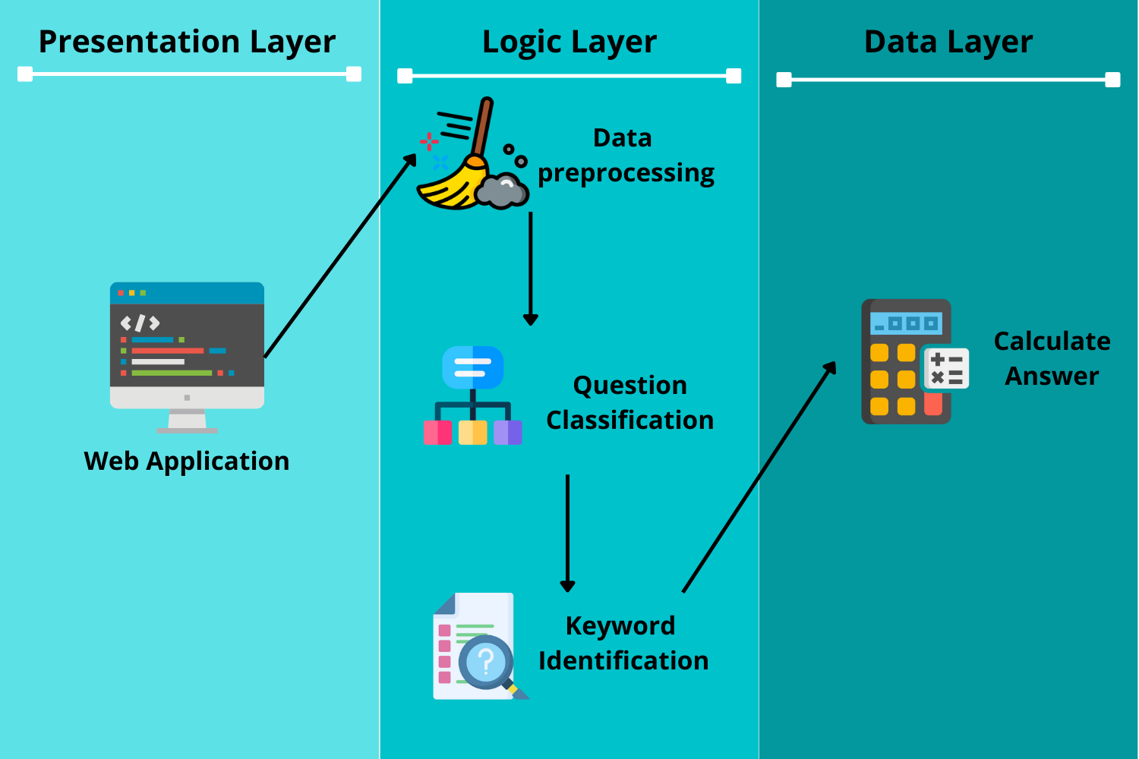
Design of System – High Level Diagram

Slide 7
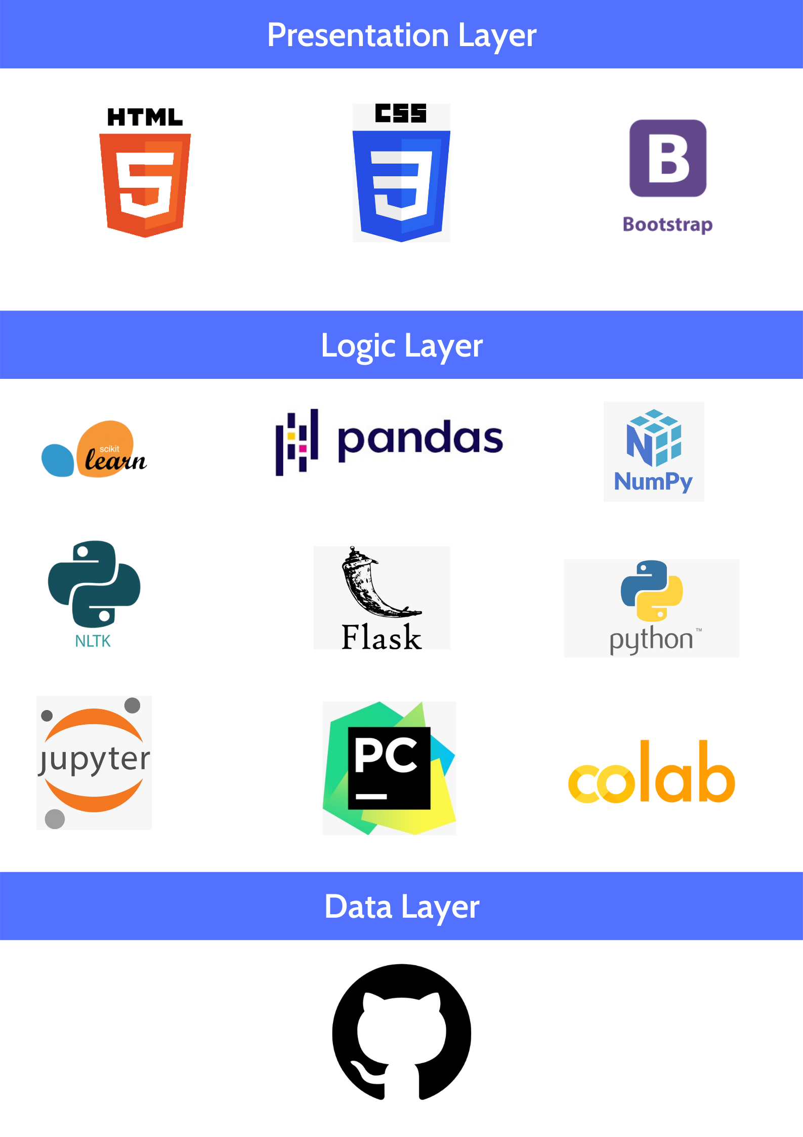
Implementation
The technologies that was used for the implementation of the solution

Slide 8
Demonstration of the Prototype

Slide 9
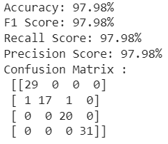
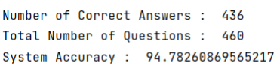
Testing & Evaluation
Evaluations
Expert’s evaluation
Self Evaluation
Focus Group Testing
Functional and Non-Functional
Testing
Classification and the system accuracy was performed (97.65% & 94.78%) Confusion matrix, F1 score, Recall and Precision
Performance testing was conducted using lighthouse extension
Functional and Non-Functional

Slide 10
Benchmarking
Model | Accuracy | F1 Score | Precision | Recall
BERT(by author) | 95% | 95% | 95% | 95%
Logistic Regression (by author) | 97.98% | 97.98% | 97.98% | 97.98%
Model | Accuracy(Model)
MathQ (author’s research) | 97.98%
Mahoshadha 2 (Chathurika et al., 2016) | 72%
MathQA (Schubotz and Scharpf, 2018) | 80%
Reference
Schubotz, M. and Scharpf, P., 2018. Introducing MathQA - A Math-Aware Question Answering System. [online] ResearchGate. Available at: <https://www.researchgate.net/publication/329125386_Introducing_MathQA_ _A_MathAware_Question_Answering_System>

Slide 11
Limitation & Future Enhancements
Limitation
Only for Sinhala Arithmetic problems
Only can solve problems with 2 numerical values and can only perform positive calculation.
Perform simple arithmetic problems
Limited data for training and testing
Future Enhancements
Deep Learning approach
Voice input and image capturing over text input
Generate steps on how to solve the problem
Unsupervised learning approach
Solve complicated questions

Slide 12
Conclusion
Use of Existing Skills
Python, web development and flask
Skills gained from SDGP
New Skills gained
Knowledge on NLP & machine learning
Different technologies in machine learning
Problems and Challenges faced
Lack of knowledge on machine learning and NLP
Lack of dataset
Contribution to the body of knowledge
Answer generation for Sinhala arithmetic problems
Logistic regression-based system
Creation of Dataset

Slide 13
Thank You

